Slide 1
SELENIUM BASICS

Slide 2
Agenda
Selenium Overview
Getting Started - Setup
Project 1 and 2 – Launching various browsers
Selenium Locators and FindElement Commands
Project 3 – Driver Commands
Project 4 – Navigation Commands
Project 5 – Workflow using Locators

Slide 3
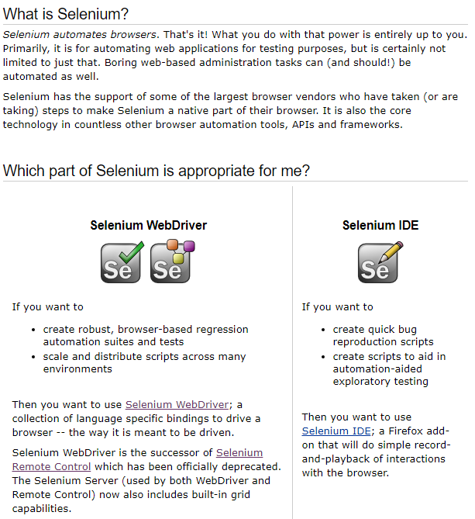

Selenium

Slide 4




Selenium IDE vs RC vs WebDriver
Selenium IDE | Selenium RC | Selenium WebDriver
It only works in Mozilla browser. | It supports with all browsers like Firefox, IE, Chrome, Safari, Opera etc. | It supports with all browsers like Firefox, IE, Chrome, Safari, Opera etc.
It supports Record and playback | It doesn’t supports Record and playback | It doesn’t supports Record and playback
Doesn’t required to start server before executing the test script. | Required to start server before executing the test script. | Doesn’t required to start server before executing the test script.
It is a GUI Plug-in | It is standalone java program which allow you to run Html test suites. | It actual core API which has binding in a range of languages.
Core engine is Javascript based | Core engine is Javascript based | Interacts natively with browser application
Very simple to use as it is record & playback. | It is easy and small API | As compared to RC, it is bit complex and large API.
It is not object oriented | API’s are less Object oriented | API’s are entirely Object oriented
It doesn’t supports of moving mouse cursors. | It doesn’t supports of moving mouse cursors. | It supports of moving mouse cursors.
Need to append full xpath with ‘xpath=\\’ syntax | Need to append full xpath with ‘xpath=\\’ syntax | No need to append full xpath with ‘xpath=\\’ syntax
It does not supports listeners | It does not supports listeners | It supports the implementation of listeners
It does not support to test iphone/Android applications | It does not support to test iphone/Android applications | It support to test iphone/Android applications

Slide 5
Getting Started
Install Java:
http://www.oracle.com/technetwork/java/javase/downloads/index.html
Install Eclipse:
http://www.eclipse.org/downloads/
Download Selenium Jars for Java:
http://www.seleniumhq.org/download/
Download driver for relevant browsers:
http://www.seleniumhq.org/download/

Slide 6
Project 1 – Launch Browser
Create Project
Import Selenium Jars
Launch Chrome Browser
Navigate To Google
Close Browser

Slide 7
Project 2 – Launch Multiple Browsers
Launch Chrome Browser
Navigate To Google
Close Browser
Launch IE Browser
Navigate To Google
Close Browser
Launch Firefox Browser
Navigate To Google
Close Browser
Notes:
IE Browser Challenges
https://github.com/SeleniumHQ/selenium/wiki/InternetExplorerDriver#required-configuration
http://toolsqa.com/selenium-webdriver/challenges-to-run-selenium-scripts-with-ie-browser/

Slide 8
Project 3 - Basic Driver Commands
Launch Chrome Browser
Navigate To Google
Close Browser
Basic Driver Commands:
get
getTitle
getCurrentUrl
getPageSource
maximize window

Slide 9
Project 4 - Driver Navigate Commands
Launch Chrome Browser
Navigate To Google
Close Browser
Driver Navigate Commands:
to
back
refresh
forward

Slide 10
Locators in Selenium
By id
By name
By link text
By partial link text
By class
By tag name
By css selector
By xpath

Slide 11
Project 5 – Workflow using locators
Launch Chrome
Search in Google
Close Browser
Search in Ascendum
Enter text Retail in Ascendum search box [By name]
Launch chrome
Navigate to google
Enter text Ascendum in google search box [By id]
Click Ascendum website link identifying it by Ascendum motto [By partial link text]
Click on the Retail link [By link text]
Click on search button [By class name]
Close the browser
Display the title and url of the last opened page

Slide 12
Remaining Topics – Selenium Basics
Remaining Selenium Locators and FindElement Commands
WebElement Commands
Handling dropdowns and multiple selections
Handling checkboxes and radio buttons
Handling tables

Slide 13
Assignment
Bing
Wiki
Close Browser
Sourcebits
Navigate to http://sourcebits.com/search/cricbuzz
Launch chrome
Go to Bing website
Search Volvo in the wiki search box
Get the title and URL of the searched page
Close the browser
Display the full file path of the downloaded page source
Search Volvo
Click on the Volvo Wikipedia page from search results
Navigate back
Get the title and URL of the current page
Compare the 2 titles and URL’s and show appropriate message on compare success/failure
Click on the Cricbuzz link
Download the page source and write to a file

